Slide 1
Circular Linked List

Slide 2
Circular Linked List:?
A link list in which last node points to the header node is called circular linked list.
It likes a linked list in which next part of the last node contains address of first node in the list.
i.e. second part of last node does not point to null pointer rather it points back to beginning of linked list.

Slide 3
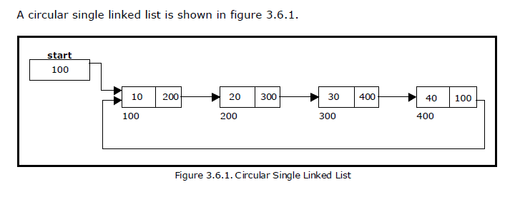
Representation of Circular Linked list

Slide 4
Operation in Circular Link List
1. Create circular linked list.
2. Traverse circular linked list.
3. Insertion into circular linked list.
At the beginning
At the end
At particular position
4. Deletion from circular linked list.
At the beginning
At the end
At particular position

Slide 5
Algorithm : Create circular linked list.
Step 1: [check for overflow]
ptr=(structnode*) malloc (sizeof(structnode))
If ptr==NULL then
Write “overflow”
Exit
End if
Step 2: ptr →info=item
start=ptr
Step 3: Initialize
read ch

Slide 6
Continue….
Step 4: repeat step 4 to 6 while ch==’y’
Step 5: cpt=(struct node*) malloc (sizeof(structnode))
Cpt→info = item
Ptr→ next= cpt
Ptr = cpt
Stpe 6: repeat choice (y/n)
Stpe 7: ptr→next =start
Step 8 :stop

Slide 7
Algorithm : Traverse circular linked list.
Step 1: [check for underflow]
If start==NULL then
Write “list is empty”
Exit
End if
Step 2: ptr=start
Step 3: print ptr->info
ptr = ptr →next
Repeat step 3 while (ptr !=start)
Step 4: stop

Slide 8
Algorithm : Insertion at beginning into circular linked list
Step 1: [check for availability]
If ptr==NULL then
Write “overrflow”
Exit
End if
Step 2: ptr→info = item
Step 3: temp = start
Step 4: repeat step 5 while temp→next != start

Slide 9
Continue….
Step 5: temp= temp→next
Step 6: ptr→next= start
Step 7: start= ptr
Step 8: temp→next = start
Step 9 :stop

Slide 10
Algorithm : Insertion at end into circular linked list.
Step 1: [check for availability]
If ptr==NULL then
Write “overrflow”
Exit
End if
Step 2: ptr→info = item
Step 3: temp= start
Step 4:repeat step 5 while (temp→next ! =start)

Slide 11
Continue….
Step 5: temp= temp→next
Step 6: temp→next = ptr
Step 7 :ptr→next= start
Stop 8:stop

Slide 12
Algorithm : Insertion after particular node into circular linked list.
Step 1: [check for availability]
If ptr==NULL then
Write “overrflow”
Exit
End if
Step 2: ptr→info = item
Step 3:read data
Step 4: temp= start

Slide 13
Continue….
Step 5: repeat step 6 while (temp→info ! =data)
Step 6: temp= temp→next
Step 7: ptr→next= temp→next
temp→next=ptr
Step 8 :stop

Slide 14
Algorithm: Deletion at beginning from circular linked list
Step 1: [check for underflow]
If start==NULL then
Write “list is empty”
Exit
End if
Step 2: temp= start
Step 3: if( temp→next ==start) then
start=NULL
Print temp→info
free(temp)

Slide 15
Continue…..
Step 4 :else perform step 5 -7
Step 5: repeat step 6 while(temp→next != start)
Step 6: temp= temp→next
Step 7:ptr = start
start=ptr->next
temp->next= start
print ptr-> info
free (ptr)
Step 8: stop

Slide 16
Algorithm: Deletion at end from circular linked list
Step 1: [check for underflow]
If start==NULL then
Write “list is empty”
Exit
End if
Step 2: ptr=start
if ptr->next == start then
start=NULL
Print ptr→info
Free(ptr)
Step 3:else perform step 4 –7

Slide 17
Continue….
Step 4: temp= start
Step 5: ptr=temp
temp=temp->next
Step 6 repeat step 5 and 6 while(temp→next !=start)
Step 7: ptr→next=start
Print temp→info
Free(temp)
stop 8: stop

Slide 18
At the particular NODE:-
Step 1: [check for underflow]
If start==NULL then
Write “list is empty”
Exit
End if
Step 2: read data
Step 3: ptr =start
Step 4: if(ptr->next==start) then
if ptr→info== data then
Print “ Deleted element is ptr→info”
start=NULL
free(ptr) End If
End If

Slide 19
Continue…
Step 5 :temp=start
Step 6 : repeat step 6 and 7 while(temp-> info!= data )
Step 7 : prev=temp
temp=temp->next
Step 8: if temp->next==start
prev->next= start
Step 9: else prev->next=temp->next
End If
Step 10: free(temp)
Step 10: Stop.

